Slide 1
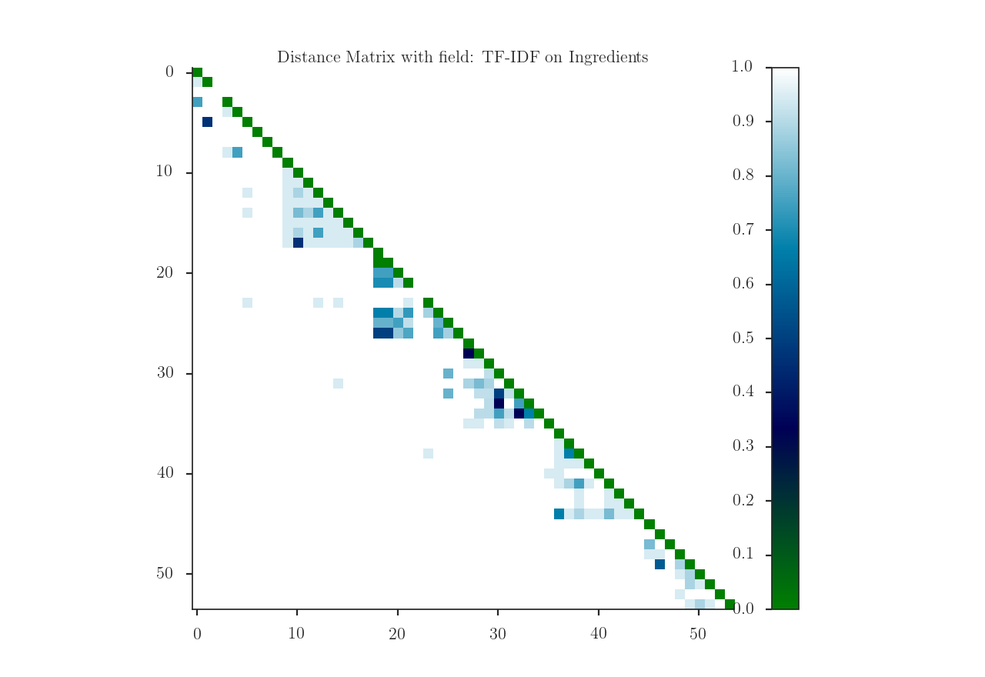
Gold Standard 1
Gold Standard 2
Gold Standard 3
Gold Standard 4
Gold Standard 5
Gold Standard 6
GS 1
GS 2
GS 3
GS 4
GS 5
GS 6

